Slide 1
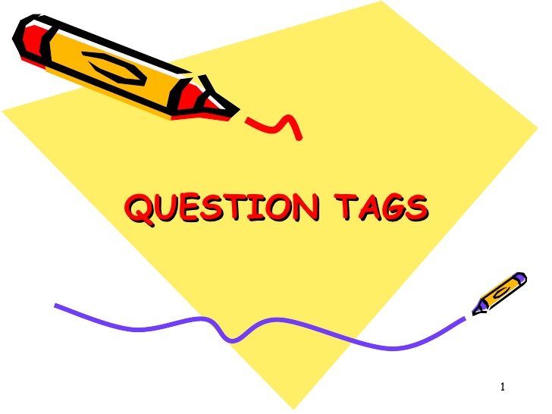

Slide 2
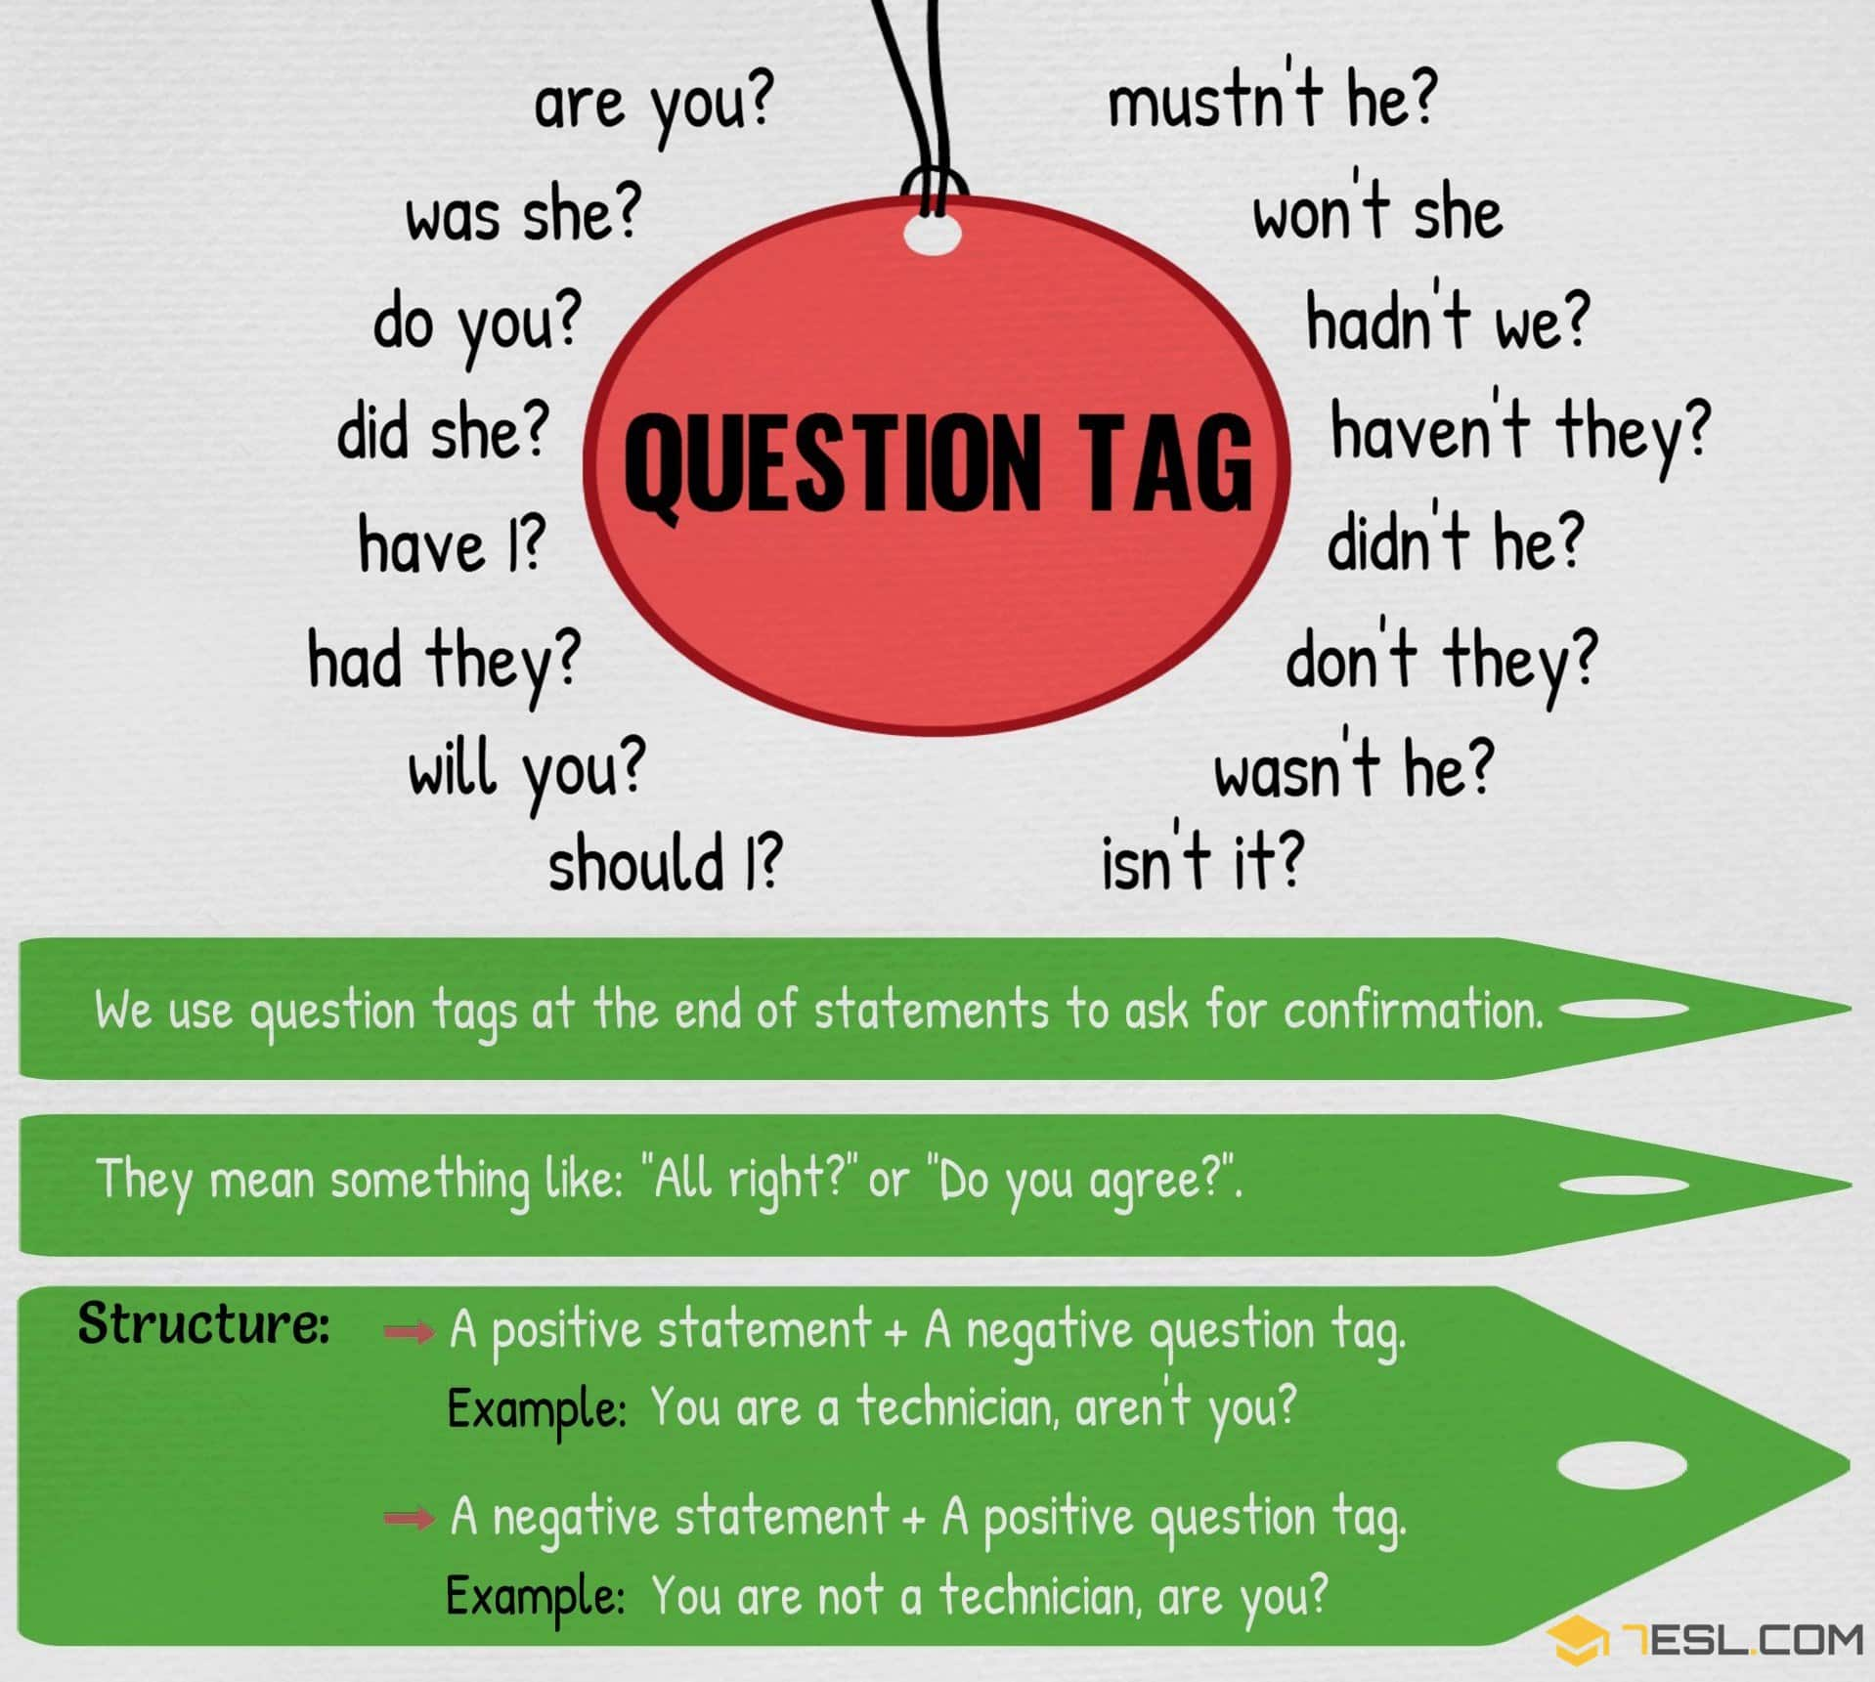
Tag questions (or question tags) turn a statement into a question. They are often used for checking information that we think we know is true.
A tag question is a special construction in English. It is a statement followed by a mini-question.

Slide 3
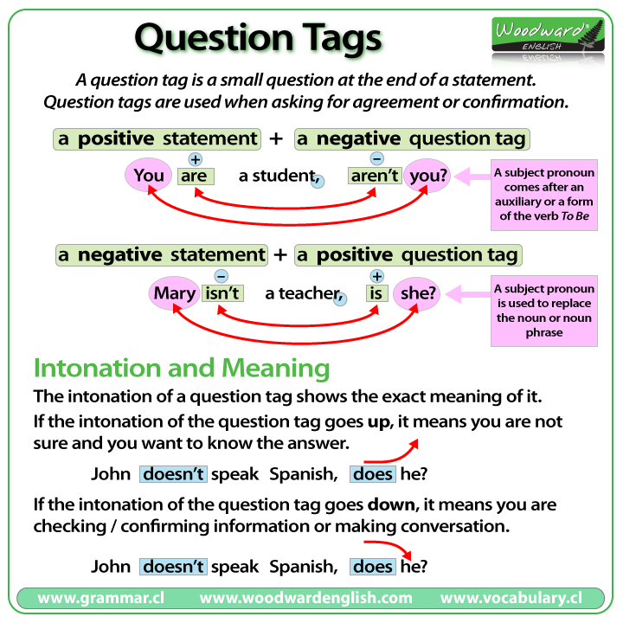

Slide 4
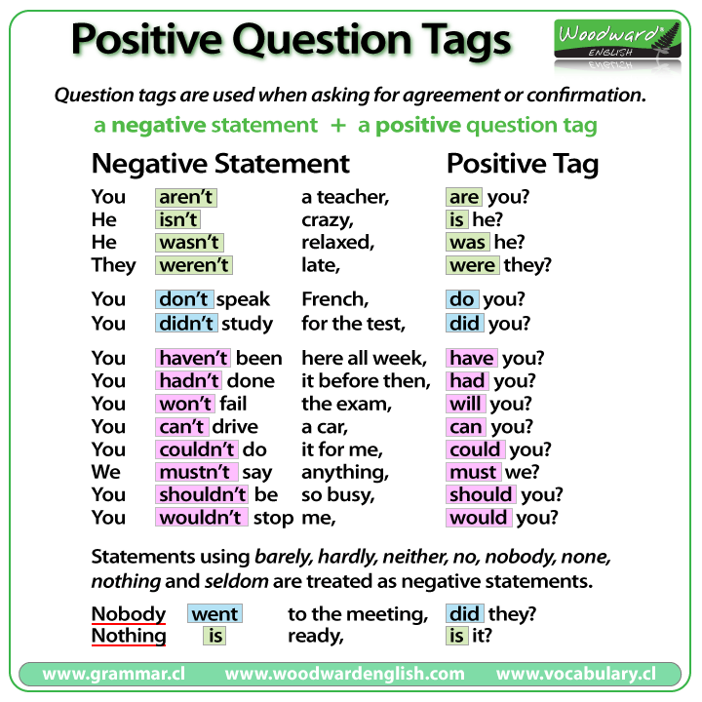

Slide 5
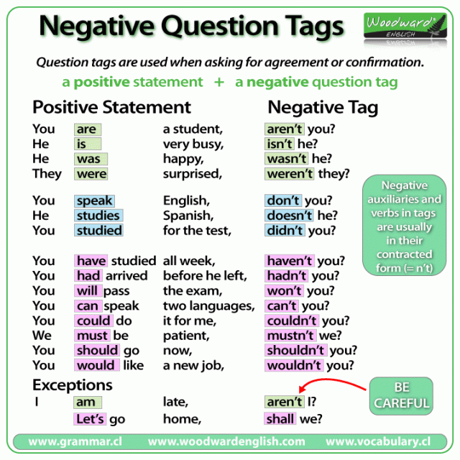

Slide 6
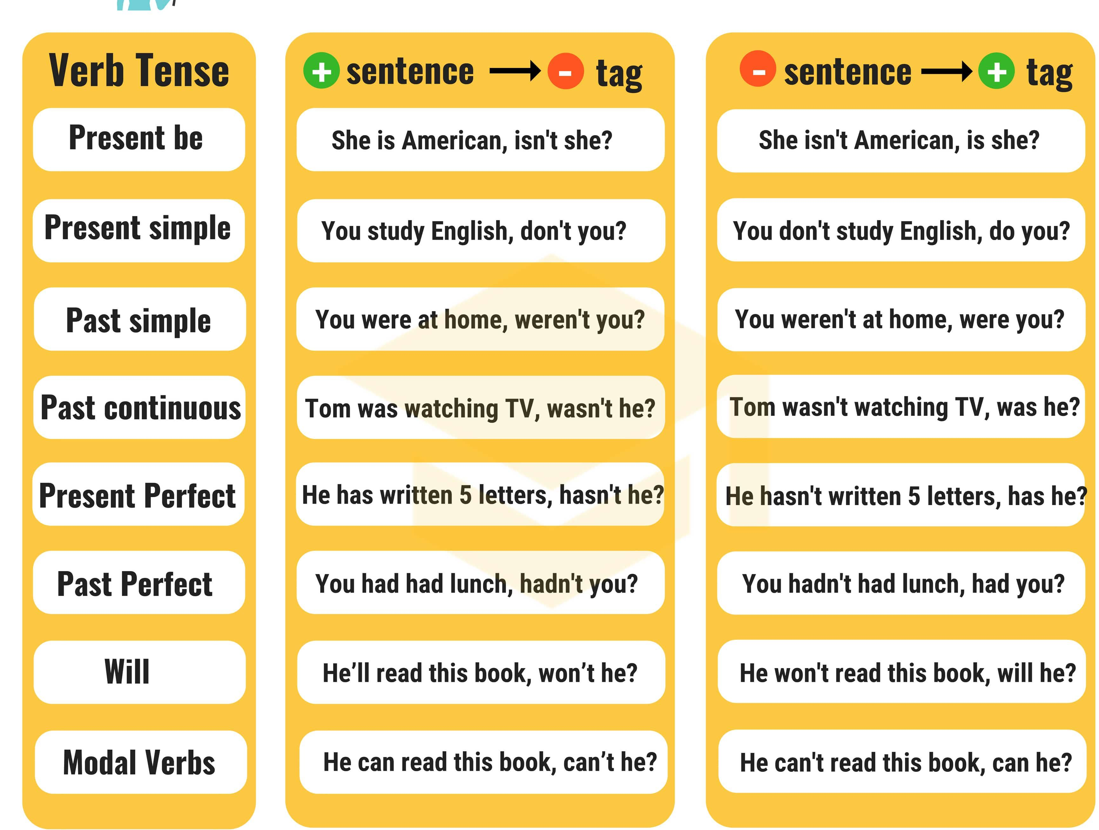

Slide 7
Exceptions
Some verbs / expressions have different question tags. For example:
I am - I am attractive, aren't I?
Positive imperative - Stop daydreaming, will / won't you?
Negative imperative - Don't stop singing, will you?
Let's - Let's go to the beach, shall we?
Have got (possession) - He has got a car, hasn't he?
There is / are - There aren't any spiders in the bedroom, are there?
This / that is - This is Paul's pen, isn't it?

