Slide 1

CONJUNCTIONS
CONJUNCTIONS

Slide 2
WHAT ARE CALLED CONJUNCTIONS?
Conjunctions are the joining words that join two or more words, phrases, or clauses in sentences.
Read the following sentences and observe the highlighted words in it:
1.Time is very important and precious.
2.It is rightly said that time is wealth.
3.The truth in this saying is obvious for wealth depends on the proper use of time.
4.We should perform our tasks regularly and punctually.
5.There is a need to utilise our opportunities as they rarely come by again once they are missed.
6.Lost wealth can be recovered but lost time is never recovered.
In the above given sentences, you must have noticed that:
In sentence 1, and joins important and precious, which are two adjectives;
In sentence 2, that joins two clauses-it is rightly said and time is wealth;
In sentence 3, for joins again two clauses
In sentence 4, and joins regularly and punctually, which are two adverbs;
In sentence 5, as joins two clauses
In sentence 6, but joins again two clauses.
We see that the highlighted words-and, that, for, and, as, but- perform the function of ‘joining’. Hence, they are called conjunctions.

Slide 3
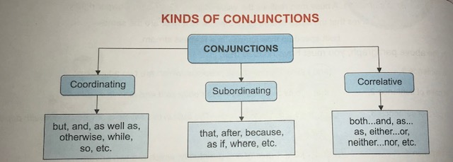
REMEMBER…
Conjunctions, unlike prepositions, are not related to any object.
As opposed to adjectives or adverbs, conjunctions never qualify or define a word.

Slide 4
COORDINATING CONJUNCTIONS:
We use coordinating conjunctions to join two words, phrases or sentences that are of the same rank or are grammatically equal or similar. These phrases/sentences can stand alone without the other’s help.
Coordinating conjunctions always come between the words or clauses that they join.
Examples-
I was tired but happy.
Susheel ran fast, yet he could not catch the flight.
My father returns home late but my mother comes home early.
SUBORDINATING CONJUNCTIONS:
Subordinating conjunctions are the words which join the dependent or subordinate clause with the independent or main clause. The words used as subordinating conjunctions include that, after, before, if ,whether, though, although, unless, as, when, since, etc.
Examples-
The boy could not lift the box because it was heavy.
Wake up early so that u may reach the venue in time.
Karan took up the challenge though it was a difficult task.

Slide 5
CORRELATIVE CONJUNCTIONS:
Correlative conjunctions or complex conjunctions are the words which are used in pairs to establish some correlation between two clauses.
Both…and, as…as, no less…than, no sooner…than, whether…or, neither…nor, either…or, etc. are included in this category of conjunctions.
Examples-
1.Snow is white some rabbits are equally white.(use correlative conjunction)
Some rabbits are as white as snow.
2.We reached the venue. The contest began that very moment.
Hardly had we reached the venue when the contest began.
3. The food is not fresh. The fruit is not fresh, either.
Neither the food nor the fruit is fresh.
4.It is unethical. It is against the law, too.
It is not only unethical but also against the law.

Slide 6
PRACTICE
Fill in the blanks with suitable conjunctions:
1.We had reached school______it started raining.
2.Sushant was _____brave_____he was honest.
3.Our car tyre was punctured______the journey was smooth.
4._____Ranjan______Ravi has reached the stadium as yet.
5.You can go home_______i will stay here for some more time.
6. _______Mr. Paul is very rich, he lives a life full of misery.

Slide 7

This Photo by Unknown Author is licensed under CC BY-NC

